Slide 1
Training Agenda
Introduction – Time management infotypes
Holiday Calendar
Time Mgt - Groupings
Work Schedule
Time Recording Methods
Absence Infotype
Absence Quota Generation Rules
CATS

Slide 2
Time Management Infotypes
IT 0007 (Planned Working time) ▪ IT 2007 (Attendance Quota)
IT 0050 (Time Recording Info ) ▪ IT 2010(Employee Remuneration)
IT 0416 ( Time Quota ▪ IT 2011 (Time Events)
Compensation)
IT 2012 (Time Transfer Specifications)
IT 2001 (Absences)
IT 2002 (Attendances)
IT 2013 (Quota Correction)
IT 2003 (Substitutions)
IT 2004 (Availability)
IT 2005 (Overtime)

Slide 3
(Infotype Maintenance-Transactions
PA30
PA20 - Dispaly
PA61
PA51
PA71

Slide 4

IMG Customizing Steps
Personnel Subarea - Employee Subgroup Groupings
Public Holidays
Daily Work Schedules
Holiday Calendar
Break
Schedules
Variants
Rules - Variants
P
eriod Work Schedules
Work Schedules
Generate
Monthly Work Schedules
Work Schedules
Infotype 0007 Plan Working Time

Slide 5
(Work Schedule)
The Daily work schedule specifies the working times and breaks
A period work schedule is a fixed pattern of daily work schedules
A work schedule rule links the following elements:
Public Holiday calendar
Period work schedule
Daily work schedule
Work break schedule
Personnel subarea grouping
Employee subgroup grouping
The work schedule rule can be defaulted on infotype 0007

Slide 6
Holiday Calendar
Public Holiday Class (Blank – No holiday, 1 – Public day)
Create a Holiday € Assign to Holiday calendar
T-code - SCAL

Slide 7
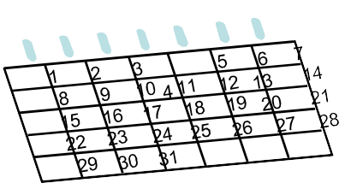
Public Holiday Calendar
SAP has two calendars used by the HR module
Public Holiday Calendar
Factory Calendar
SAP provides standard Public Holiday calendars for most countries.
All calendars are customizable in SAP
SAP Calendars are not client-specific
Used in many areas e.g. logistics and HR

Slide 8
Public Holidays Classes
Public Holiday Class Blank
-
Working day
Public Holiday Class 1
-
Full day Public Holiday
Public Holiday Class 2
-
Half a day Public Holiday
Public Holiday Class 3 - 9
-
Customer Specific

Slide 9
Public Holiday Calendar
The Holiday Calendar will have the list of holidays. Holidays should also be configured as Full Day Public Holiday and Half a Day Public Holiday
Holidays may be Fixed (Fixed date), Movable (varies from year to year) and can also be configured as distance from Easter

Slide 10
Time Management Groupings
SAP provides the following groupings in Time recording
Personnel Subarea Groupings
Employee Subgroup Groupings
Groupings allow the user to, for example
Define different work schedules for groups of employee’s
Assign different rules for deviations to planned working time
Permit only certain attendance’s and absences to be posted for certain groups of employee’s

Slide 11





Define Personnel Subarea Groupings:
Personnel Subarea grouping for Work Schedules
Daily Work schedules:
Personnel Subarea grouping for Work Schedules
01
Norm (8H) Norm (10H) Executives (9H) Early
Late
02
A
C
B
Night Off
Personnel Subarea grouping
for Work Daily Schedules
Personnel Subarea grouping
for Work Daily Schedules
01
Normal (8H)
Executives (9H)
Early
02
Late
Night
Off
Normal (10H)
Early
Late
Night
Off

Slide 12








Personnel Subarea Grouping
All The Personnel Subareas which share the same Work Schedule will be grouped together
Factory Maintenance
Marketing
Administration
01 01
Factory and Maintenance Department grouped as 01 as they work in shifts and they share the same working times
02 02
Marketing & Admn Department grouped as 02 as they share the same working times

Slide 13
Personnel Subarea Grouping
For Work schedule
For Daily Work Schedule
View: V_001P_ALL

Slide 14
Employee Subgroup Grouping
All The Employee Subgroups which share the same Work Schedule will be grouped together
Salaried
Trainees
Hourly wage earners
1
1
2
Salaried Staff and Trainees share the same work schedules and are grouped as 1
Hourly Wage earners work different times and are grouped as 2

Slide 15
Employee Sub-Group Grouping
View : V_503_ALL

Slide 16
Daily Work Schedules
How an employee works during a day
What is the timing
How much late coming or early going is tolerated
When does he have break
In case of flextime – Specify planned, Normal and core times

Slide 17
Daily work schedule variant
Definition : V_T550X
Assignment : V_T550A
3 conditions for selection of variant
#Holiday Class for the day
#Holiday class for the next day
#Weekday
You can have many variant for a DWS. When all above conditions meet, specific variant will be selected.

Slide 18

Rule for Daily Work Schedule Variant
Rule
No
Hol. Class Curr Day
b 1 2 3 4 5 6 7 8 9
Hol.Cl Next Day
b 1 2 3 4 5 6 7 8 9
Day of Week
1 2 3 4 5 6 7
Variant
X – True
. - Not True

Slide 19
Daily Work Schedule - Shifts
Early Shift EARL
Personnel Subarea Grouping
If the employee works in 3 shifts there would be 3 Daily Work Schedules
01
08:00 16:00
To
Middle Shift MIDD
Personnel Subarea Grouping 01
16:00
To
24:00
Night Shift
NIGH
Personnel Subarea Grouping
01
0:00
To
08:00

Slide 20
Period Work Schedule
Period Work Schedule is a pattern of daily work schedule which the employee will be working
In this example, the employee works from 9:00 to 17:00. Name of the Daily Work Schedule is 6DAY
1
2
3
4
5
6
7
01
6DAY
001
6DAY
6DAY
6DAY
6DAY
6DAY
6DAY
OFF

Slide 21
Weekly off
For Weekly off there should be a separate Daily Work Schedule in which the option “No planned working hours is to be checked”
OFF
Weekly Off
Checkbox
No Planned Working Hours
No timings need to be entered in this Daily Work Schedule as it is meant for an OFF day

Slide 22
Period Work Schedule – Rotating Shift
The Employee works in three shifts namely EARL, MIDD and NIGH – There would be a rotating pattern
 |  |  | 1 |  | 2 |  | 3 |  | 4 |  | 5 |  | 6 |  | 7
01 | ROTA | 001 | EARL |  | EARL |  | EARL |  | EARL |  | EARL |  | OFF |  | OFF
01 | ROTA | 002 | MIDD |  | MIDD |  | MIDD |  | MIDD |  | MIDD |  | OFF |  | OFF
01 | ROTA | 003 | NIGH |  | NIGH |  | NIGH |  | NIGH |  | NIGH |  | OFF |  | OFF
When the Work Schedule is generated this pattern would be repeated over a period specified

Slide 23
Period Work Schedule – Rotating Shift – Change of Shift every two days
Here the Daily Working times is changing every two days. Hence the full cycle ending with Night Shift has to be specified. 001 to 006 denote the
week numbers.
1 2 3 4 5
6
7
01 | ROTA | 001 | EARL |  | EARL |  | MIDD |  | MIDD |  | NIGH |  | OFF |  | OFF
01 | ROTA | 002 | NIGH |  | EARL |  | EARL |  | MIDD |  | MIDD |  | OFF |  | OFF
01 | ROTA | 003 | NIGH |  | NIGH |  | EARL |  | EARL |  | MIDD |  | OFF |  | OFF
01 | ROTA | 004 | MIDD |  | NIGH |  | NIGH |  | EARL |  | EARL |  | OFF |  | OFF
01 | ROTA | 005 | MIDD |  | MIDD |  | NIGH |  | NIGH |  | EARL |  | OFF |  | OFF
01 | ROTA | 006 | EARL |  | MIDD |  | MIDD |  | NIGH |  | NIGH |  | OFF |  | OFF

Slide 24
Public Holiday Calendar attached to Personnel Subarea
The public holiday calendar has to be attached to each Personnel Subarea which would be bound by these holidays
Personnel Area | Personnel Subarea | PH Cal
CHEN | ADMN | IN
CHEN | ACCT | IN
CHEN | PROD | ZN

Slide 25
Day Types
Day types are meant for public holiday classes. Whether the employee will Work on Public Holidays and whether he will be paid or not
Day Types Blank
1
2
3
Work/Paid Off/Paid Off/Unpaid Off/Special Days

Slide 26

Day Type Rule
Day Type Rule specifies the Day Type for Public Holiday Classes
Weekday
Saturday
Sunday
b 1 2 3 4 5 6 7 8 9
b 1 2 3 4 5 6 7 8 9
b 1 2 3 4 5 6 7 8 9
On Working day the employee has to Work to get paid, on Full Day Public Holiday Day Type is 1 – Off and paid. This rule will be referred in Work Schedule Rule. In this example, the same rule is applicable for Weekday, Saturday and Sunday

Slide 27
Work Schedule Rule - Continued
Working hours entered in Work Schedule Rule will be defaulted in Infotype 0007 when Work Schedule Rule name is entered
Daily
8
Annual
1920
Weekly
40
Monthly
160
No. of workdays in a week
5

Slide 28
Work Schedule Rule - Continued
The Period Work Schedule, Starting point, Reference day and day type rule will also be referred in Work Schedule Rule
Period Work Schedule
NORM
01.01.1990
Reference Date
Starting point
001
Day type Rule
01

Slide 29
Generate Work Schedules Manually
The Work Schedule has to be generated and only then it can be attached to an employee in Infotype 0007
ESG Grouping 9
PSA Grouping
40
Holiday Calendar
IN
Work Schedule Rule
From period To period
General
12/2006
01/2008

Slide 30
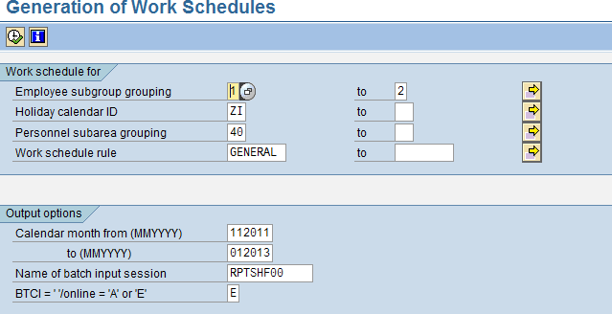
Batch Method

Slide 31
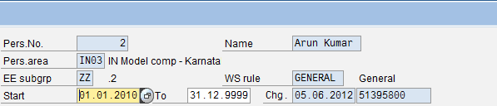
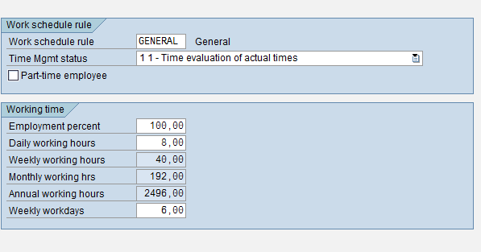
Infotype 0007
The Work Schedule generated is to be attached to an employee in Infotype 0007

Slide 32
What does Time Management Status specify? And what are the possible values?
Time Management Status specifies whether an employee participates in Time Evaluation
Possible values of TMS are:
0 -- No Time Evaluation
1 -- Time Evaluation, Actual Times
2 -- Time Evaluation, PDC
7 -- Time Evaluation without Payroll Integration
8 -- External Services
9 -- Time Evaluation, Planned Times

Slide 33
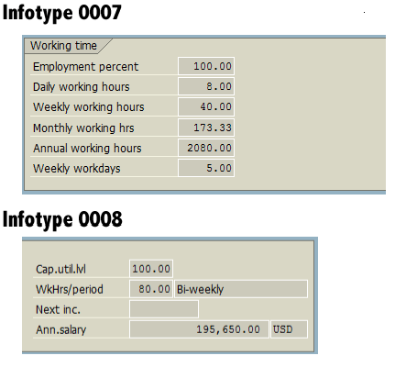
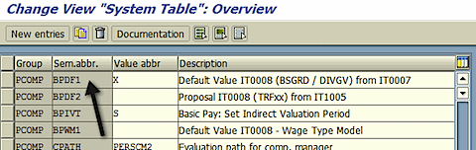
Link between IT 0007 & IT 0008
it will copy entries from 0007 to 0008 if this entry is made in T77S0 and if feature DFINF is set.

Slide 34
Time Recording Methods
Positive Time Recording
Negative Time Recording

Slide 35
Time Recording : Negative
Records time deviations to planned working time
Valid deviations include:
Absences
Special absences
On call duty
Overtime
Substitutions
Time off in lieu
Deviations are manually entered according to type and duration

Slide 36
Time Recording : Positive
Records the attendance times of an employee
Records the deviation times of an employee
Valid attendance's include:
Training
Business trip
Seminar
Overtime
Attendance's and deviations can be entered either:
Front-end system
Manually

Slide 37


Time Recording : Method
Capture
Time sheet entry using ESS
Employee enters time sheets using ESS
Electronic data capture
Employee use machines to punch a card
Employee swipes a card at a time terminal
Importable file formats
Time admin submits data in importable file format

Slide 38

Time Recording in Time Management
Time recording in time management
Allows the entry of employee time data
Manually
Automatically
Allows data to be entered as clock times
Allows data to be entered as hours
Time data is entered in time recording infotypes
Time recording infotype range 2000 - 2999

Slide 39


Absences / Attendances
Absences
Attendance / Absence
Leave
2001
Quotas
Entitlement
Attendance's
2007 / 2006
0005
2002

Slide 40


SAP Time and Payroll Integration with External Time Devices
MANUFACTURING PLANT SAP System
Time Recording Terminals
Master Data
Secured FTP Server
Secured
FTP Server
Clock server
Files
LSMW /BDC/PI
T & A
Payroll
Time recording terminals will capture the time data and record it on clock server
Time data input file will be generated from clock servers and placed on the FTP server
Time Data will be loaded to SAP using SAP PI/LSMW/BDC for time evaluation
SAP payroll engine will use SAP time data to generate pay checks

Slide 41

SAP Payroll Integration with External Time Systems
Customer
SAP SYSTEM
T&A System
Master Data
Time Recording Terminals
Secured FTP
Server
Secured FTP
Server
LSMW
/BDC/PI
Payroll
s
Master data will be maintained in SAP and sent to FTP Server for loading into T&A system
Time Recording Terminals will capture the time data and T&A System will do the validation and evaluation
Consolidated data from T&A system will be loaded to FTP Server
Time Data will be loaded to SAP using SAP PI/LSMW/BDC for Payroll processing
SAP to SAP integration will be through RFCs

Slide 42
Absence Management & Quota Accrual

Slide 43
Absence / Attendance Configuration Elements
Entry Screens and Time constraint classes
Absence/Attendance Counting
Absences / attendances TYPES
Personnel Subarea groupings
Indicators for the personal calendar
QUOTAS
Quota type 99
Quota type 01-98
Leave Entitlement 0005
Quotas 2006/2007

Slide 44
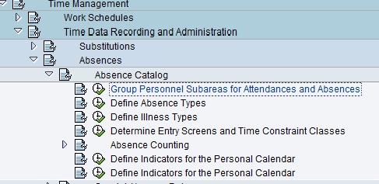
Absence IT 2001

Slide 45
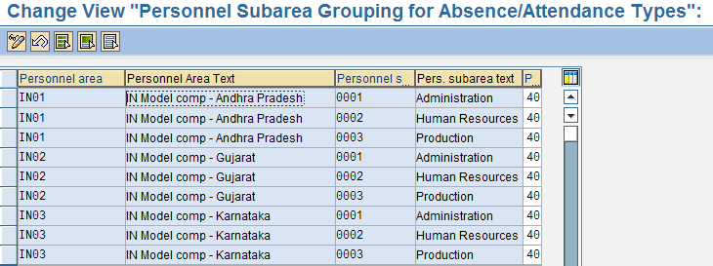
Grouping of PA- PSA for Absence types

Slide 46
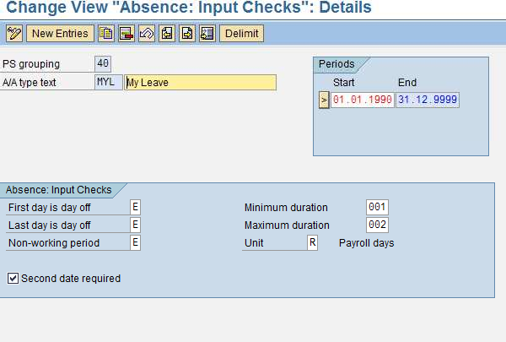
Define Absence Type

Slide 47
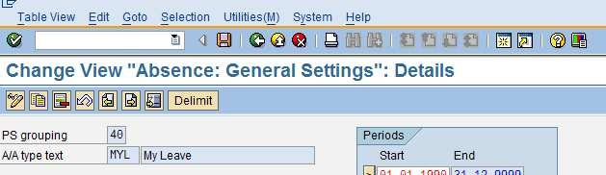
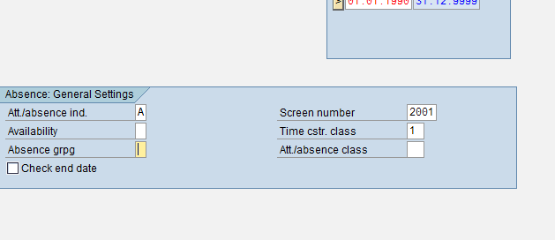
Entry Screen and Time Const. Classes

Slide 48
Entry Screen for IT 2001
The following screens are currently available: Absences:
- 2000 | Absences (general)
- 2001 | Quota deduction

Slide 49
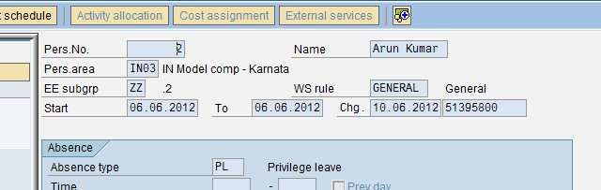
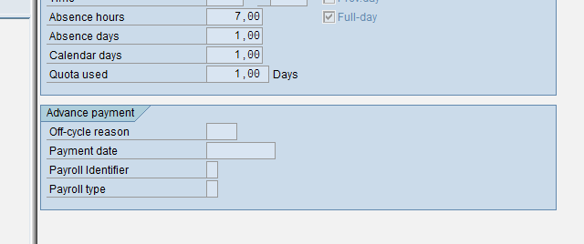
IT 2001 : PL : Screen 2001

Slide 50
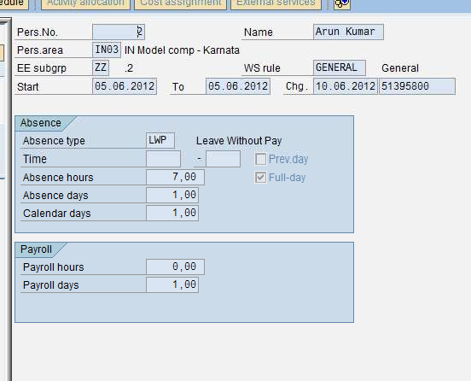
IT 2001 : Screen 2000 : No Quota

Slide 51
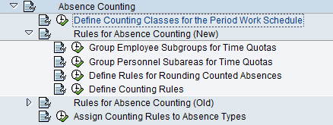
Absence Counting

Slide 52
Define Rules for Absence Counting
Configuration:
Group employee subgroups for time
1 quotas
Group personnel subareas for time
Define rules for rounding counted
2
quotas
3
absences
Assign counting rules to absence types
Define counting rules
5
4

Slide 53
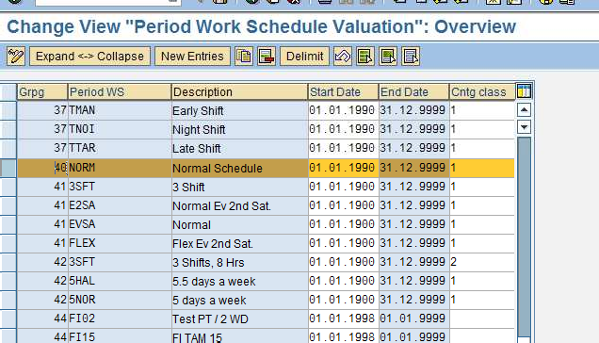
Counting Class for PWS

Slide 54
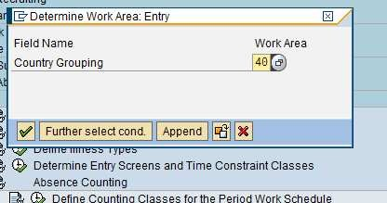


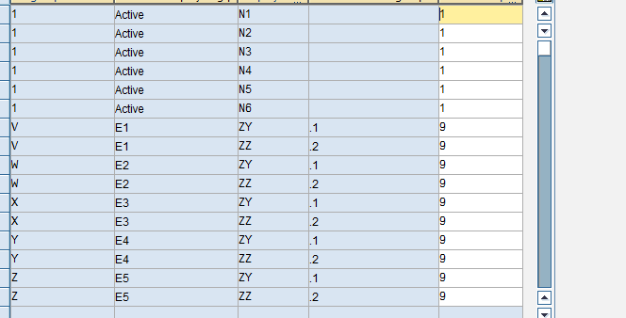

Slide 55
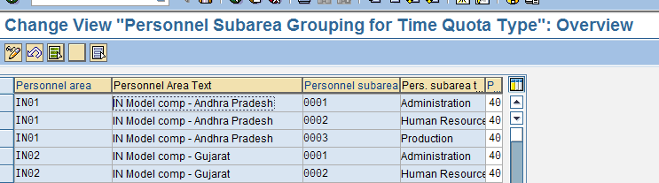
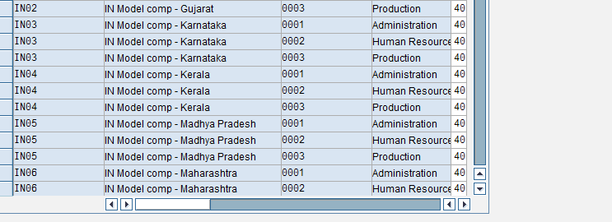
PA PSA Grouping

Slide 56
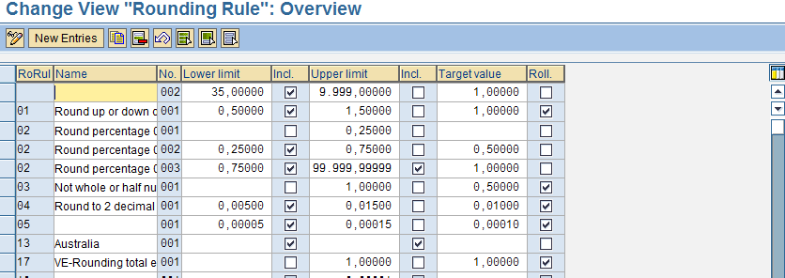
Rounding Rule

Slide 57
Rounding Rule
Quotas can be rounded for which we can specify the conditions for rounding in a rounding rule
The lower limit and upper limit can be specified along with the target value for rounding.
We can either include or exclude the lower or upper limit for the purpose of rounding
If we select checkbox “Roll” the target value would be rolled for subsequent intervals

Slide 58
Counting Rule
Applicability of Rule
Condition for Current Day
Weekday
Holiday Class
Condition For Work Schedule
Counting class for PWS
DWS Class
Condition for planned hours
Condition for absence/ Attendance
Counting
Deduction Rule

Slide 59
Counting Rule
We assign a deduction rule in a counting rule
Counting rule will specify the conditions for counting an absence
Counting Rule
101
Sequence Number
001

Slide 60
Counting Rule Contd…
Checkboxes for Monday to Sunday would be available and these have to be checked if the leave is to be counted on these days
Counting Classes can be attached to Period Work Schedules which can be queried in the counting rule
DWS class given in the Daily Work Schedule can be queried in the Counting rule. Only absences for those employees who belong to the selected category would be counted using this rule. If one rule is not satisfied system will process the sub-rules sequentially
The Holiday Classes blank to 9 can be queried and counted if required
The Day types can be queried in the counting rule
Less than one day and one day options are available in the counting rule
Planned hours =0 and Planned hours > 0 options can also be used for counting
System will count the leave only if all the selected conditions are satisfied

Slide 61
Counting Rule Contd…
Rounding can also be done during counting.
Whether to Count first or Round first radio button option to be selected
The Deduction rule framed earlier has to be referred in counting rule either in within entitlement or over entitlement field.
Within entitlement
100
Over entitlement

Slide 62
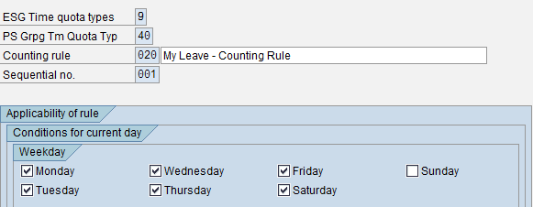
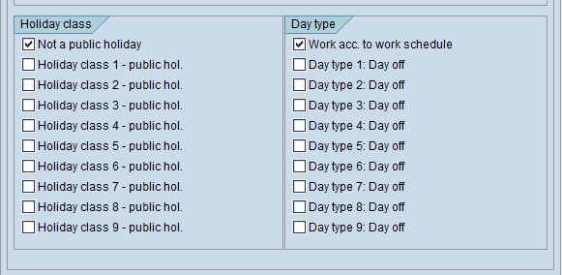
Counting Rule

Slide 63
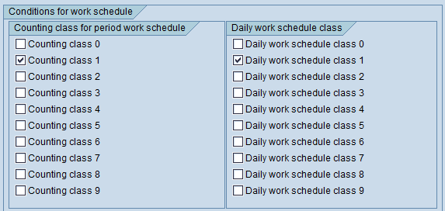
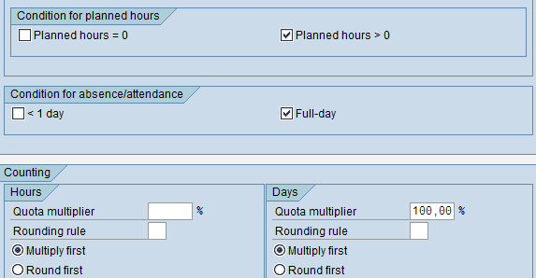
Counting Rule Cont.

Slide 64
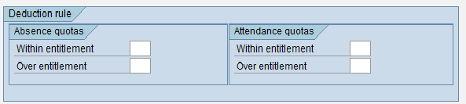
Counting Rule Cont..

Slide 65
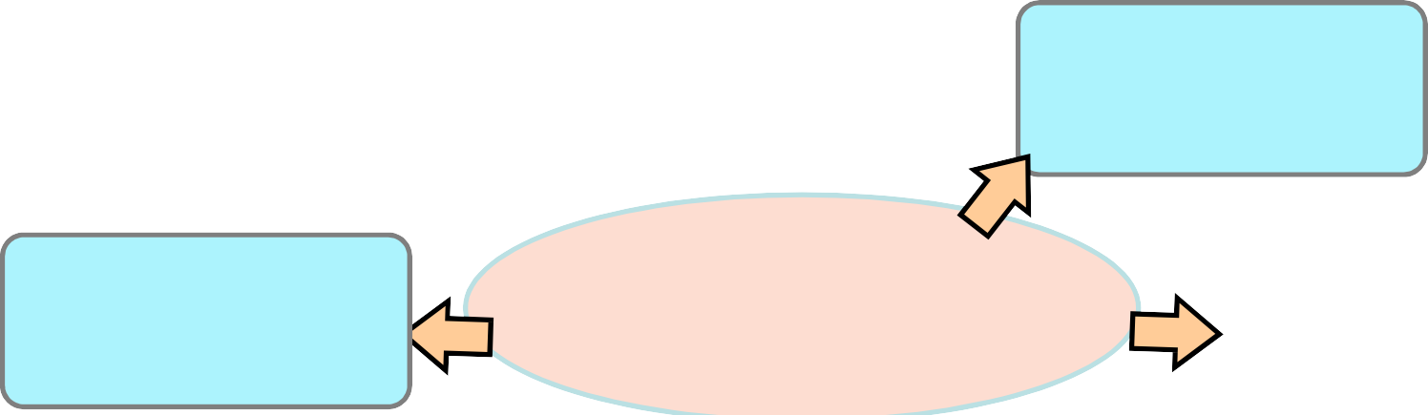
Define Counting Rules
Weekday:
Public Holiday Class:
Monday - Saturday
Blank
Daily Work Schedule Class, Day Type:
Absence Type: Casual Leave
Period Work Schedule Class:
Working Days
All
Hours
Days
Quota Multiplier 50%
Quota Multiplier 100%
Hours 4
Days 1
Deduction of Quota
Deduct Full day

Slide 66
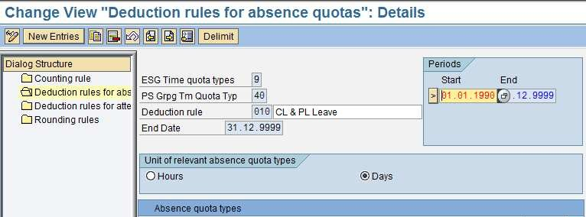
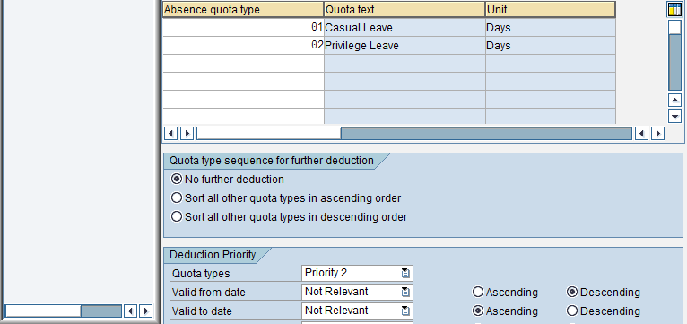
Deduction Rule

Slide 67
Deduction Rule
Deduction rule Specifies the Deduction of Quotas ,the sequence in which they have to be deducted and also the priority of deduction
There may be more than one quota for the same absence type. The order of deduction of these quotas have to be specified
The priorities can be Quota types, Validity from date, Validity to date, deduction from date and deduction to date.
The Validity interval is the period for which quota has accrued. The Deduction interval is the period in which the quota can be used.

Slide 68
Deduction Rule - continued
Priority 1
Quota type
The priorities of Validity and Deduction can be ascending or descending
Priority 2
Priority 3
Validity from
Validity to
Priority 4
Priority 5
Deduction from
Deduction to
Whether the quotas would be in Days or Hours would also be specified in a Deduction rule

Slide 69
Assign counting rule to absence types

Slide 70

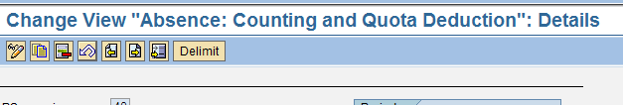
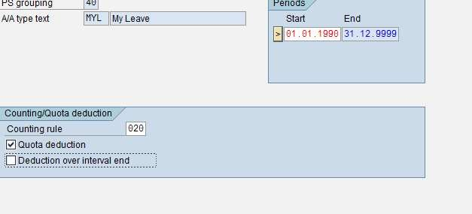
Assign Counting Rule to Absence

Slide 71
Assign Counting Rule to Absence Types
The Counting rule has to be assigned to the absence type for which the quota is created.
This step will connect the quota and absence.
The checkbox for deduction of quota has to be activated so that the quota would be reduced if the absence is recorded
The Checkbox for deduction over interval end can be selected if the leave starting from deduction end date and extending beyond that date is to be allowed or not

Slide 72
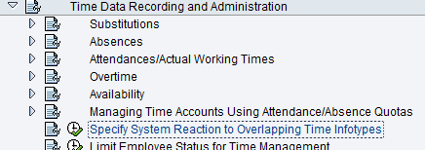
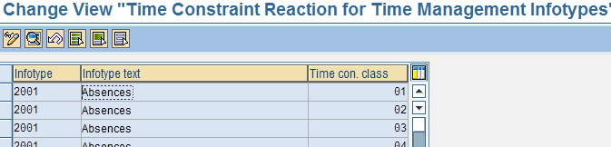
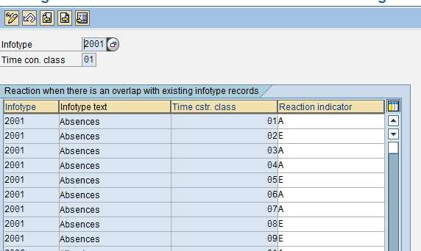
Reaction to Overlapping Time Infotype

Slide 73
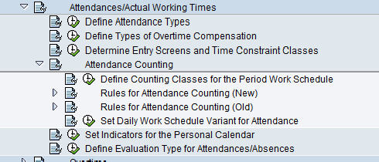
Attendance IT 2002

Slide 74
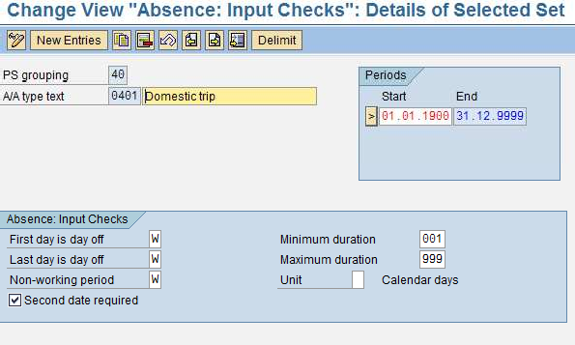
Define Attendance

Slide 75
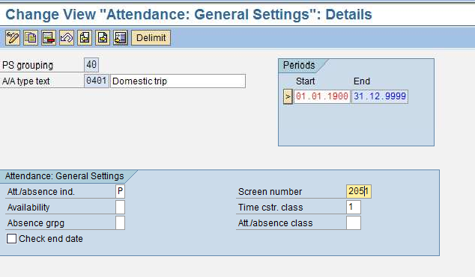
Attendance : Entry Screen
2050 – Quota Deduction 2051 – No Quota Deduction

Slide 76
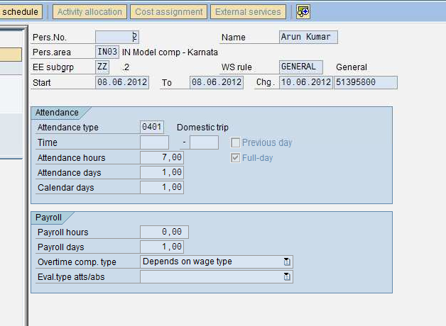
Attendance IT 2002

Slide 77
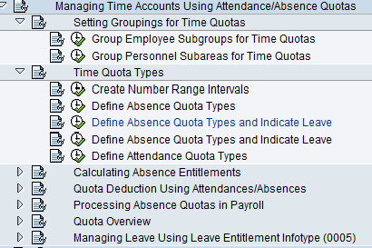
Time Account : Absence Quota

Slide 78
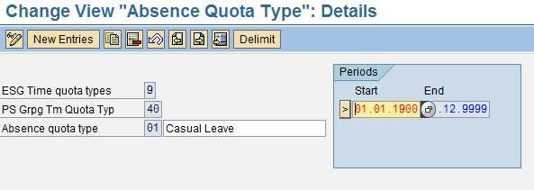
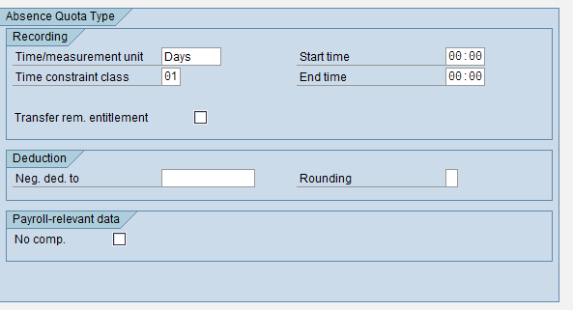
Define Absence Quota Type

Slide 79
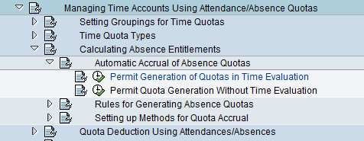
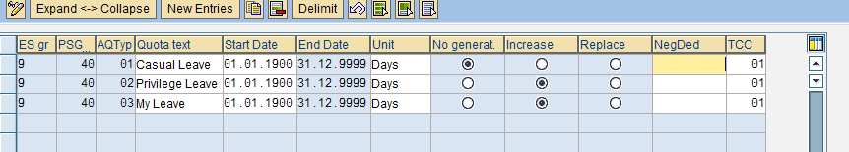
Permit Quota Generation
For quota types that will be manually accrued and created, check “No generation.” For quota types that will be automatically accrued (by time evaluation or the generation program), check “Increase” or “Replace.” If “increase” is selected, each accrual amount transferred will add to the existing entitlement. “Replace” will overwrite the existing entitlement
when accruals are transferred.

Slide 80
Generation Rule
Generate Rule incorporates
Base Entitlements
Reduction Rule
Rounding Rule
Based on Challenge percentage of employee different generation rules can be framed
Based on date of entry, different generation rules can be framed
The maximum entitlement can be restricted in the generation rule

Slide 81
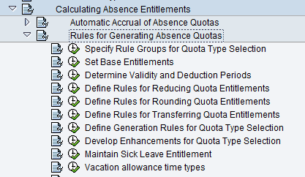

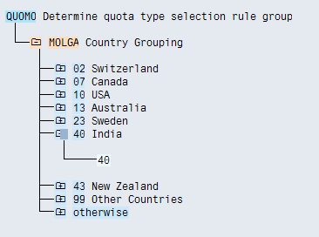
Rules For Generating Absence Quota

Slide 82
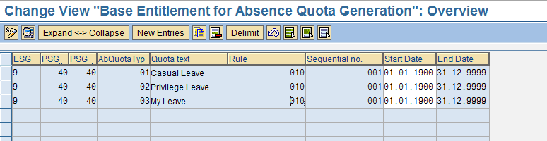
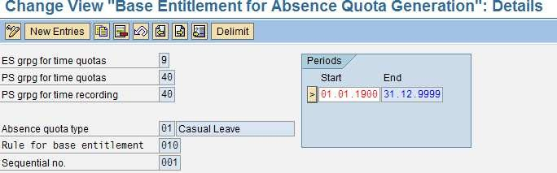
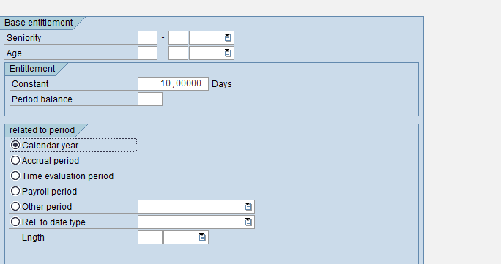
Base Entitlement

Slide 83
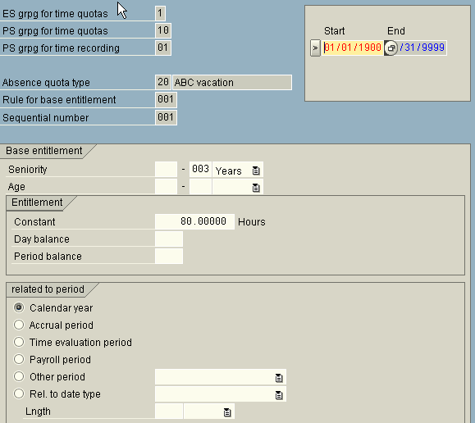
Based on seniority - 1

Slide 84
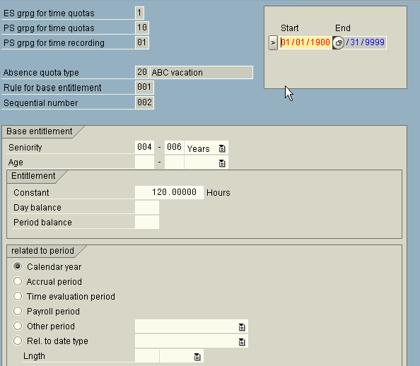
Based on seniority - 2

Slide 85

Based on seniority - 3
It defines the constant amount for the quota based on seniority. In the first screen, that the Sequential Number is 001, the Seniority is 000-003 years, and the Constant is 80.00 hours. In the second screen, the Sequential Number is 002, the Seniority is 004-006 years, and the Constant is 120.00 hours. In the third screen, the Sequential Number is 003, the Seniority is 007-999 years, and the Constant is 200.00 hours.
In the Related to period section, the period is set to Calendar year. This means that the constant entitlement amounts are for the calendar year, ie. 200 hours per year.

Slide 86
Validity Interval and Deduction Interval

Slide 87
Validity Interval
Validity Interval is the period for which the quota is to be accrued.
We may specify validity interval as start of calendar year to end of calendar year or alternatively, other periods can also be specified as validity interval.
While giving the validity interval, the quota type selection rule group will also be specified.

Slide 88
Deduction Interval
Deduction interval is the period in which quota can be used.
Different quotas can have different deduction intervals

Slide 89


Determine Validity and Deduction Periods

Slide 90


Determine Validity and Deduction Periods

Slide 91


Reduction Rule

Slide 92
Reduction Rule
Quota can be reduced proportionately for part-time employees based on part-time percentage in Infotype 0007
Quota can be reduced proportionately for employees based on Capacity Utilisation percentage in Infotype 0008
For employees who join or leave in the middle of the year, based on inactivity, quotas can be reduced

Slide 93
Generation Rule

Slide 94
Generation Rule
Generate Rule incorporates
Base Entitlements
Reduction Rule
Rounding Rule
Based on Challenge percentage of employee different generation rules can be framed
Based on date of entry, different generation rules can be framed
The maximum entitlement can be restricted in the generation rule

Slide 95
Default of Quotas

Slide 96
Default of Quotas
QUOMO feature defaults quotas based on Quota Type Selection Rule Group
The Generation Rule and Validity periods would refer the Quota Type Selection Rule Group
Based on the Quota Type Selection Rule Group QUOMO will default the quotas if report
RPTQTA00 is run or when Infotype 2006 is created

Slide 97

Quota Generation Rule

Slide 98


Applicability

Slide 99
Applicability cont..
Earliest accrual date: corresponds to a date on Infotype 0019 – Monitoring of Dates. For example, if the employee’s accrual should not start until after they complete a probationary period of time, you can specify the date/deadline type from IT0019 here.
Entry date: Specify a period of time for which the rule should be applicable based on the employee’s entry date. Keep in mind that this date is derived from the entry date on IT0000. (See section in this document on Feature HDATE for more details). If entry date is not relevant, leave the fields blank or use a greater period for the entry date (01/01/1800 - 2/31/9999, for example).
Challenge Group/Degree of challenge: specify details on the employee’s disability, if applicable.

Slide 100

Accrual Period
In the Accrual Period section, select one of the following options:
Daily: Entitlements are calculated daily. This means the base entitlement for the year is divided by 365 to calculate the daily accrual.
Month: Period from first day to last day of the month. This means the base entitlement for the year is divided by 12 to calculate the monthly accrual, and the accrual takes place at the end of the month.
Calendar Year: Period of one year, from 01/01/XX to 12/31/XX. This means the base entitlement for the year is accrued at the end of the calendar year.

Slide 101
Accrual Period Cont ..
Time evaluation period: Period determined in time evaluation, defined in the Determine time evaluation period step in the IMG. The accrual takes place at the end of the time evaluation period.
Payroll period: Period determined in payroll; valid payroll period of the day to be evaluated of the payroll area of the employee to be evaluated. The accrual takes place at the end of the payroll period.
Other period: Individually specified period; period parameters are defined in the Define period parameters step in the IMG. This period is particularly useful if you have irregular accrual periods that may begin in the middle of the month. The accrual takes place at the end of the period.
Rel. to date type: Period is defined in relation to a date type from the Date Specifications Infotype (0041). You determine the accrual period using the length field (for example, the date the employee joined the company, with a period of one month.)

Slide 102


Base Entitlement

Slide 103


Base Entitlement Cont.

Slide 104
Base Entitlement Cont.
If the quota is based on seniority, you must choose one of the following options:
For exact day: This option will use the employee’s entry date from IT0000 as the key date for determining seniority. This means any change in the employee’s seniority is taken into account within the accrual period.
Start/End of accrual period: This option will use the employee’s entry date from IT0000 as the key date for determining seniority. This means any change in the employee’s seniority is taken into account at the start of the next accrual period.
Start/End of base period: This option will use the employee’s entry date from IT0000 as the key date for determining seniority. This means any change in the employee’s seniority is taken into account at the start of the next base period.
Date Type: This option will use a specified date on the employee’s IT0041 record as the key date for determining seniority. This means any change in the employee’s seniority is taken into account on the date specified in the date type, with the current year.
Quota entitlements based on age are handled in a very similar manner – thesame
fields apply as with seniority.
- 138 -

Slide 105

Accrual Entitlement

Slide 106
Accrual Entitlement Cont..
Pro rata calculation means in order to determine the appropriate entitlement based on the period, the accrual period is compared with the base period of the quota type currently being processed, and a proportionate accrual entitlement is determined. It means the total base entitlement of the quota type currently being processed is always used as the basis for the accrual entitlement.
You can also choose to multiply the accrual by a time balance. If you want to generate the accrual entitlements on the basis of accountable attendance times, enter either a day balance or period balance in the Multiplication by time balance section.
You can use alternative quotas to manage the capping differences that result from deduction or from the maximum entitlement being exceeded. Determine whether you want to store the capping differences and assign the applicable quota types.

Slide 107

Total Entitlement
The maximum entitlement specifies the maximum amount that can be transferred to a quota type.
For example, if an employee accrues 7 hours during an accrual period based on their time worked, and this field is set to 6 hours, only 6 hours can be transferred to the quota.

Slide 108

Validity period for default value

Slide 109


RPTQTA00 – Quota Generation

Slide 110
CATS (Cross Application Time Sheet)

Slide 111
CATS BASICS
CATS = Cross-Application Time Sheet
Time capture and data transfer tool
Additional functionality for Payroll and FI/CO
CATS uses the SAP Human Resources authorization concept
CATS may be updated via transaction code CAT2 or via a company intranet Web site
Data entry in CATS may be done by individual employee or by
defined groups of employees
CATS may be used as the time transfer tool to update Human
Resources with hours worked b⁻y¹⁸⁴e⁻ mployee

Slide 112
Benefits of Using CATS for Time Sheets
Several advantages to both employee and employer are easily identifiable.
Employee | Employer
Time entry at any time, anywhere | Decentralized time recording
Fewer administrative steps | Reduction in administrative work
Ease of use | Standard Web browser

Slide 113
SAP Provides 4 Solutions
CATS Classic
For HR / Time Administrator for multiple EE entry.
CATS Regular**
Can be used through web browser in ESS application
Extensively Used
CATS Notebook
Good for marketing employees, whom internet is not accessible all times.
CATS for service Providers
For temporary contract EE .
Offer with to specify basic data that is valid for more than a day.

Slide 114



CATS – Initial Screen & Data Entry View

Slide 115
Using CATS Data: Updating HR
Attendances/Absences (Infotypes 2001/2002)
CATS feeds HR actual hours attended or absent
CATS validates absences with absence quotas
Payroll uses Infotype 2001/2002 data during processing Substitutions (Infotype 2003)
Position option may be used to assign payment for the work
according to the specifications of a different position Employee Remuneration Infotype 2010)
One-time earnings/deductions may be passed from CATS to HR
Used to process manually – calculated wages or bonuses Work Tax Area (Infotype 0208)
CATS allows a work tax area to default area in Infotype 0208.

Slide 116


Transferring CATS Data using CAT6

Slide 117
SAP transactions:
CAC1 : Maintain profiles
CAC2 : Fields assignments
CAT2 : Use the Cross Application Time Sheet
CAPS : Approve Time Entries
CATA : Transfer All time entries
CADO : Report on Time Entries

